Slide 1

HATE SPEECH DETECTION
Project for Artificial intelligence for Cybersecurity 22/23
Filippo Sechi

Slide 2



WHAT ARE WE DEALING WITH?
Social media are a way for users to interact with each other
People tend to be «a bit aggressive» when typing behind a monitor
Cyberbullying, racism, homofobia, offensive language are all threats that must be addressed
Is there a way to understand if a comment is hate speech?

Slide 3









DATASET AND GOALS
The dataset is taken from here
Comments taken from various sources:
vs
Each comment is labeled as Hateful or Not
Can we train a classifier and censor those comments?

Slide 4
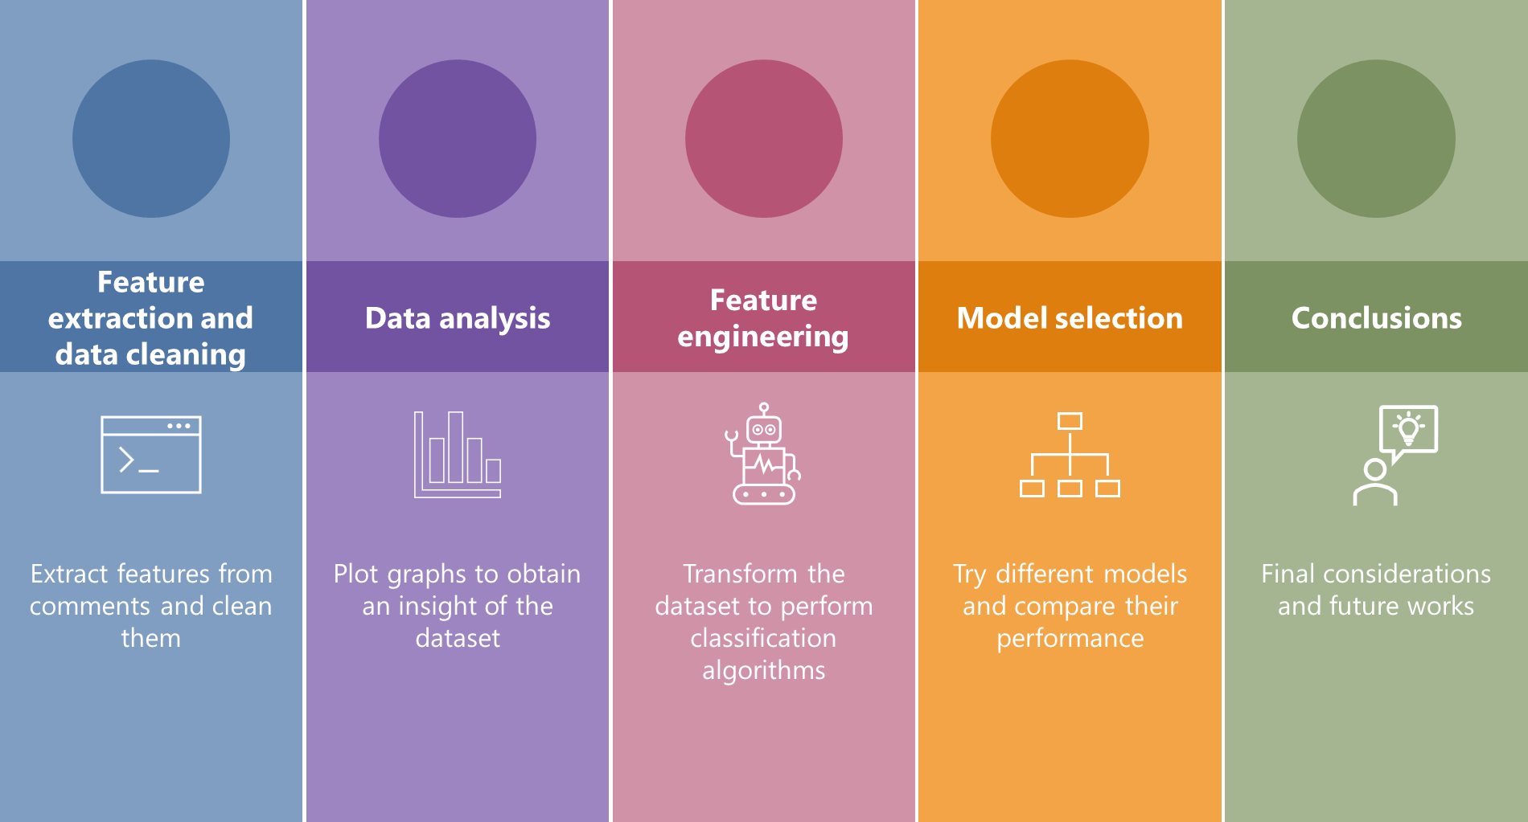
ROADMAP

Slide 5
FEATURES EXTRACTION
The dataset has the following structure: 842336x2
Content: the comment
Label: 0 / 1 (No hateful / Hateful)
Which features can be extracted from a social media comment?
Hashtags
Hyperlinks
User mentions
Digits
Length
Upper case chars
Special chars
Profanities

Slide 6
FEATURES EXTRACTION
Feature extraction example: (this is the raw data)
For all the asshole who don’t understand what fascism is, it’s literally on our doorstep, happening now at a southern border near you. #Fucktrump #ImpeachmentNOW #ImpeachTheMFer #ImpeachTrump https://t.co/vVv5cNGd5F
Count and remove all links => 1
Calculate the length => 191
Count the upper case chars => 12
Count the hashtags => 4
Count the user mentions => 0
Count the digits => 0
Count the special chars => 7

Slide 7
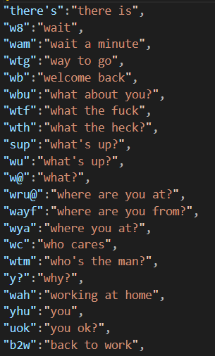
FEATURES EXTRACTION
People use tricks to mislead censorship: B1TCH instead of BITCH, S3X instead of SEX
Before analyzing profanities, we need to replace contracted forms into their full form
Contraction.json
For all the asshole who do not understand what fascism is it is literally on our doorstep happening now at a southern border near you Fucktrump ImpeachmentNOW ImpeachTheMFer ImpeachTrump

Slide 8
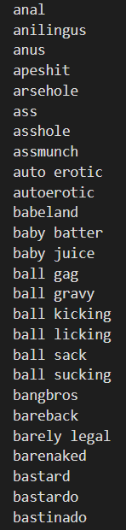
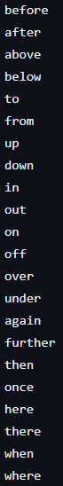
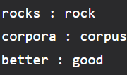
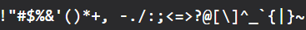
DATA CLEANING
Profanities.csv
NLTK’s stopwords
Lemmatization
Punctuation and digits
perform
Last steps:
count
remove
remove
For asshole understand fascism literally doorstep happening southern border near Fucktrump ImpeachmentNOW ImpeachTheMFer ImpeachTrump

Slide 9
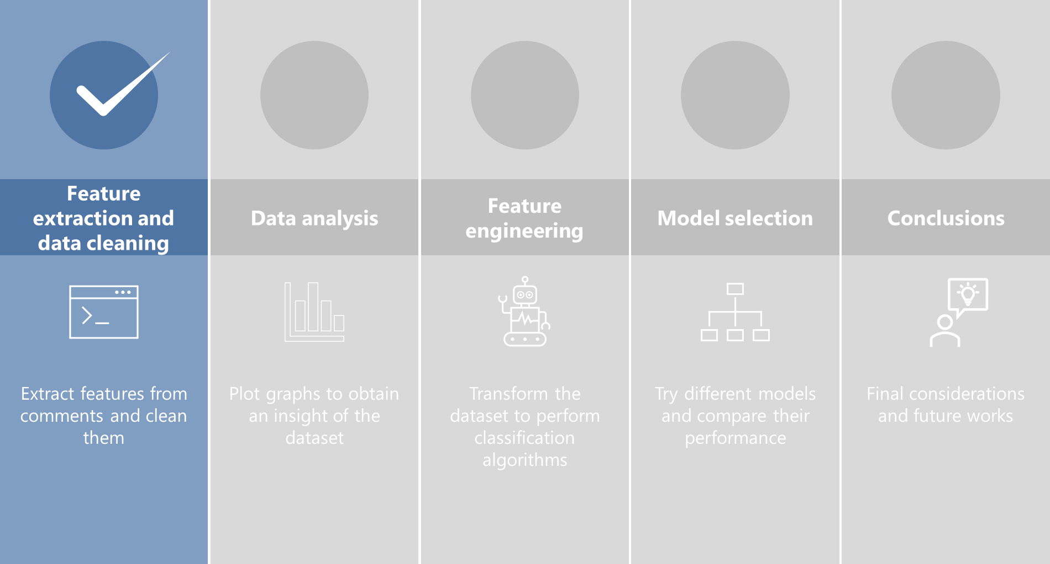
ROADMAP

Slide 10
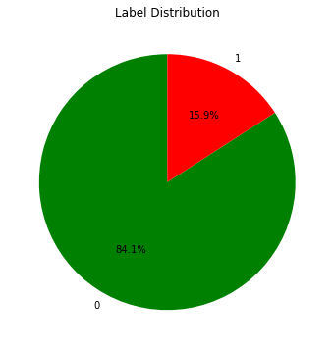
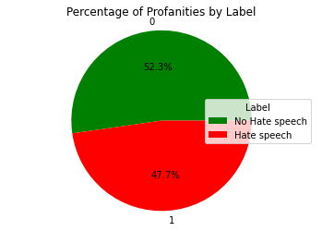
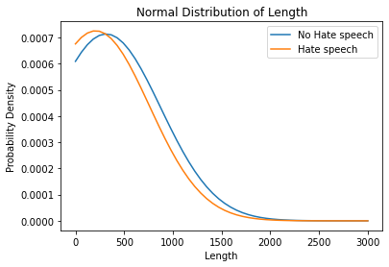
DATA ANALYSIS
Let’s see how labels are distributed in the whole dataset
What about profanities?
And length?

Slide 11
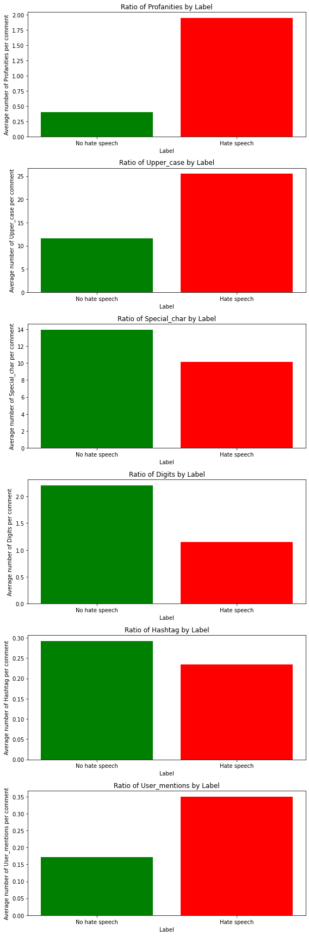
DATA ANALYSIS
What’s the average count of all the attributes for each label?
Only Profanities and Upper_case seem to have a significant difference

Slide 12
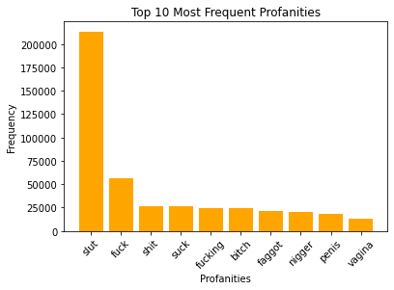
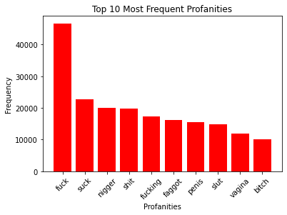
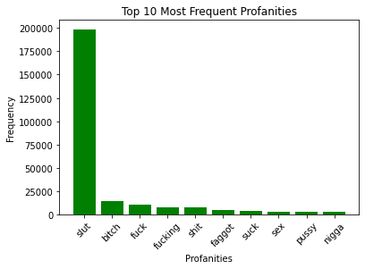
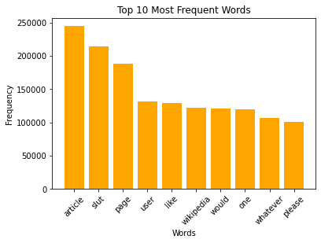
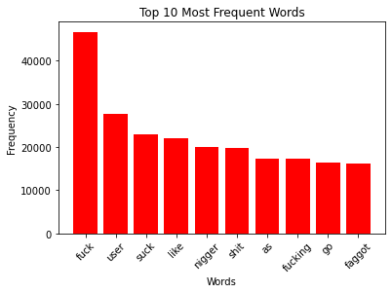
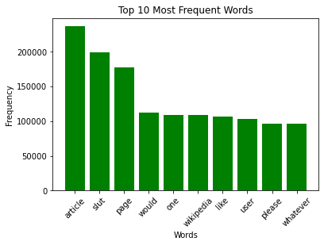
DATA ANALYSIS
What are the most frequent profanities and words?

Slide 13
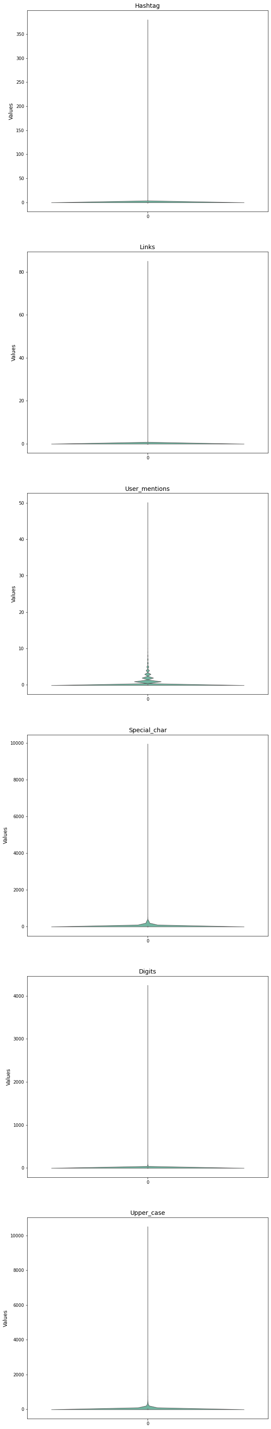
DATA ANALYSIS

Slide 14
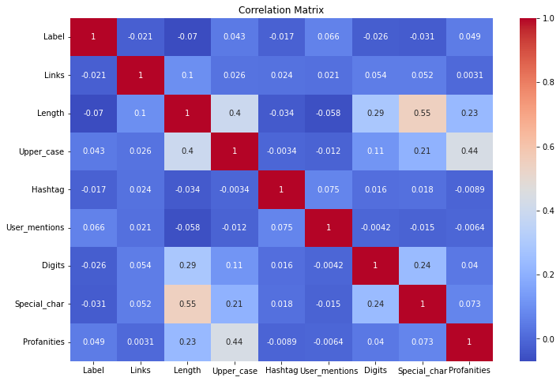
DATA ANALYSIS
Most comments have a low count on most attributes.
There are some outlier that must be removed.
From the correlation matrix, no attributes
seems to be strongly correlated
No attribute dropped

Slide 15
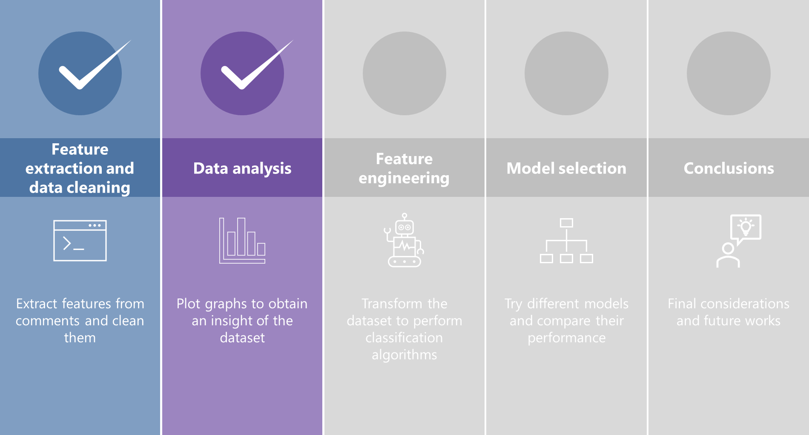
ROADMAP

Slide 16
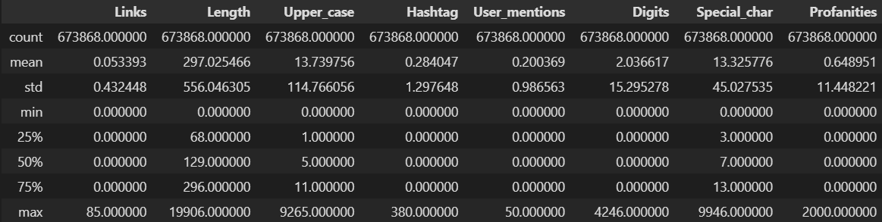
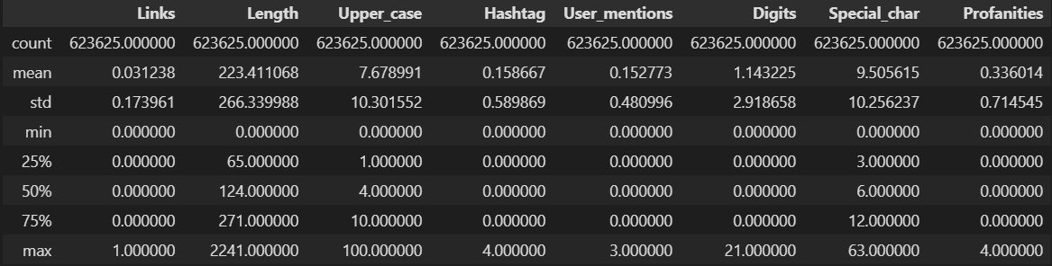
FEATURE ENGINEERING – outlier detection
Description of training set
Z-score outlier detection (threshold = 3.5)
Outliers for attribute Length -> 9750
Outliers for attribute Links -> 3428
Outliers for attribute Upper_case -> 4049
Outliers for attribute Profanities -> 5472
Outliers for attribute Hashtag -> 11532
Outliers for attribute User_mentions -> 4789
Outliers for attribute Special_char -> 7350
Outliers for attribute Digits -> 3873

Slide 17
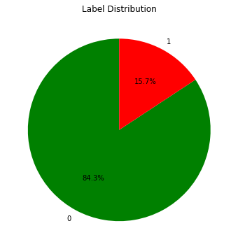
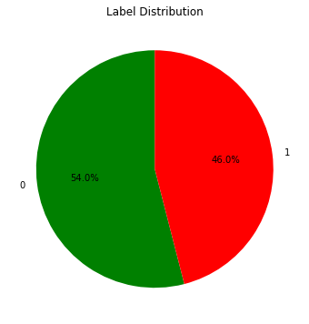
FEATURE ENGINEERING – rebalance
Class distribution of training set
Undersample
with replacement

Slide 18
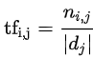
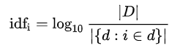
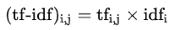
FEATURE ENGINEERING – scaling and TF-IDF
Features are scaled with RobustScaler which
scales the data according to the quantile range
More robust to outliers
Text data are converted to numerical values by means of TF-IDF
(term frequency–inverse document frequency)
Directly proportional to the frequency in the document
Inversely proportional to the frequency in the collection
(both techniques are applied by fitting with the training set and then transforming both sets)

Slide 19
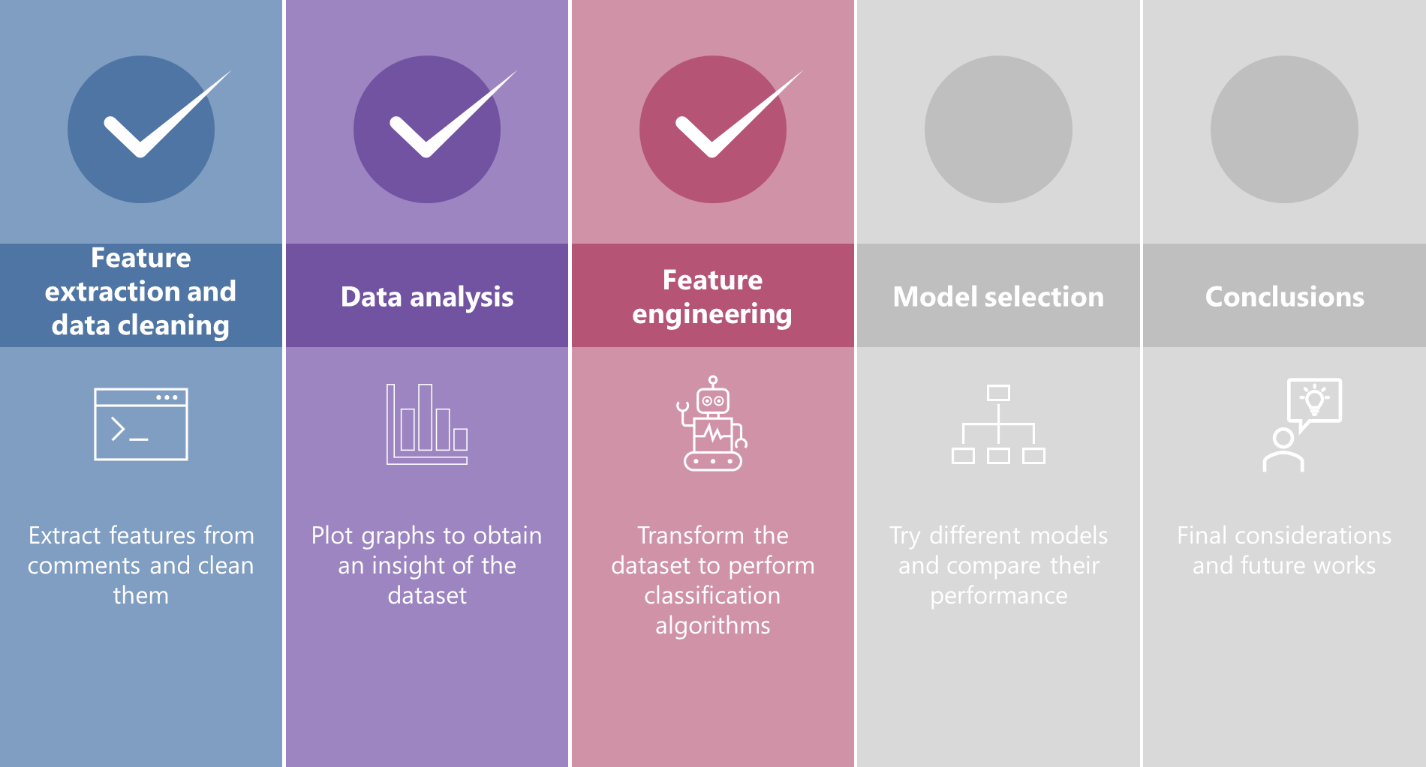
ROADMAP

Slide 20
MODEL SELECTION
Different combinations of features selection algorithms and classifiers:
- PCA + Logistic regression
- SelectKBest (mutual_info_regression) + Gradient boosting
- Random forest (gini) + Random forest (gini)
- RFE (SVM) + SVM
- Random forest (entropy) + GaussianNB
- Random forest (gini) + Decision tree
- PCA + K-Neighbors
Every combination is run by selecting 50-100-150-200 max_features
The collected metrics are: accuracy, precision, recall, f1_score, ROC_AUC and confusion matrix
They are collected as the mean of the results of cross validation (Stratified cross validation, k=10)

Slide 21
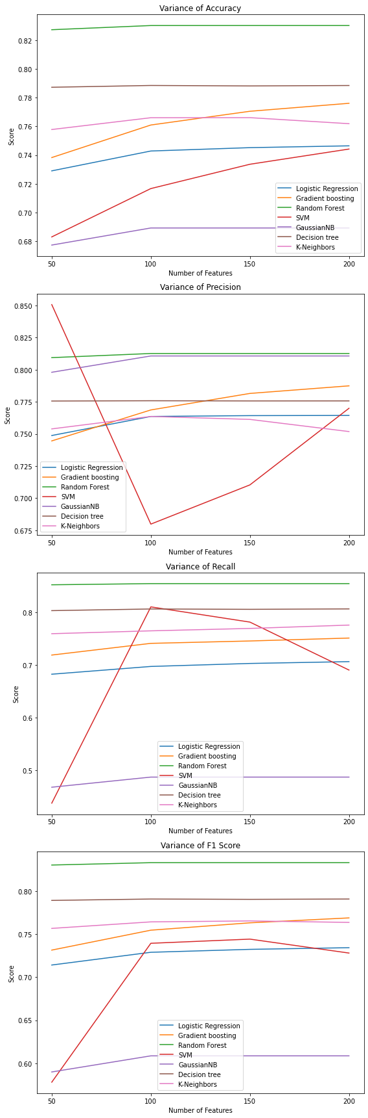
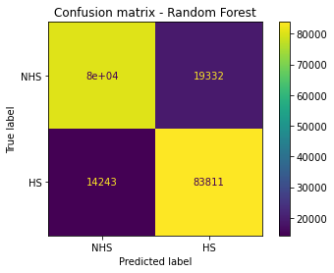
MODEL SELECTION
Full results can be found
here:
Features selected 100
Model: Random Forest
Accuracy: 0.8302
Precision: 0.8126
Recall: 0.8547
F1-Score: 0.8331

Slide 22
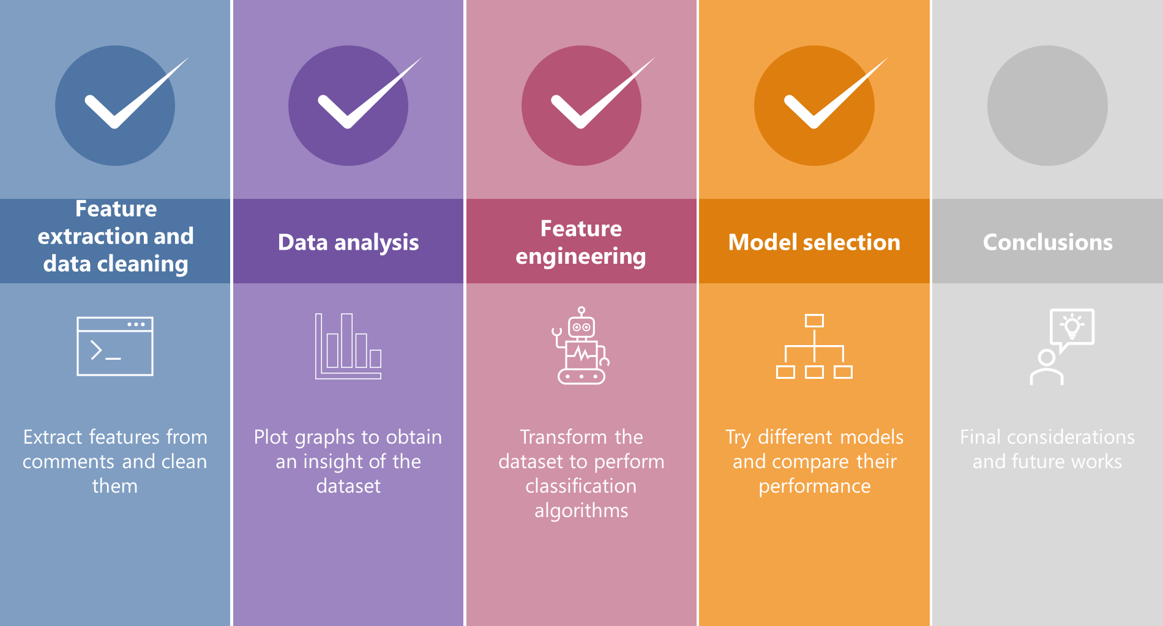
ROADMAP

Slide 23
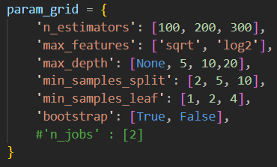
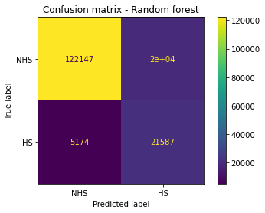
CONCLUSIONS – final test
Random Forest with 100 features (selected with PCA) performed better than other classifiers in all metrics
Tune parameters of the classifier and look for the best combination (custom scoring function) :
Accuracy: 0.8532
Precision: 0.5246
Recall: 0.8067
F1-Score: 0.6358

Slide 24

CONCLUSIONS – improvements
Final results show a high number of FP (over-censorship?)
Improvements can be done:
Try a mix of undersampling and oversampling (SMOTEENN?)
Select more features both during TF-IDF and feature selection algorithms
TRAIN DIFFERENT MODELS FOR DIFFERENT SOCIAL MEDIA

Slide 25
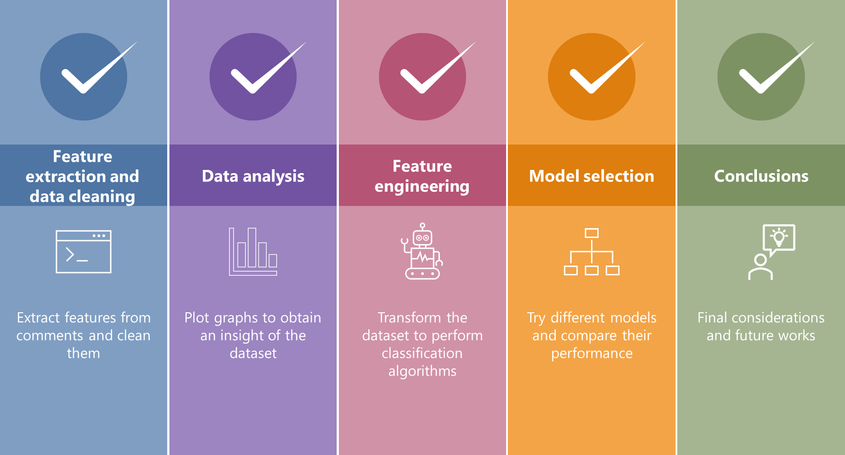
ROADMAP

